Slide 1

Anti-Virus Solutions

Slide 2
AV – The realm of snake oil
Anti-virus is important.
It’s not the most important thing.
It’s not the only thing.
What makes a “good” AV has very little to do with efficacy.
If it is competent, it is sufficient.
Beware the salesman bearing the “best” AV based upon secret proprietary algorithms or heuristic devices.

Slide 3
What makes a competent AV
Real-world protection
Lab simulations of malware transactions (malicious URL, attachments, etc.)
Malware protection
Execution of malware under controlled settings.
Performance test
Analysis of performance impact on host system.
False positive rates
False alarms, false blocks, etc.

Slide 4
Anti-Virus Scan States
There are three states of data – At rest, in motion, and in use.
At rest is on disk, inert, in storage.
In motion is when data is being transmitted – HTTP, FTP, SMTP, morse code, signal flags, whatever.
In use is when data is loaded into memory and is actively being used for some process or instruction.

Slide 5
AV scanning states
Quick / Deep Scans
AV scans of data at rest are what the technology began with. Scans were scheduled and scope established. AV solutions still do this, but it’s usually ancillary these days due to improvements in real-time efforts.
Real-time protection
Real-time protection, on-access scanning, background guard, resident shield, auto protect, and other synonyms refer to the automatic protection provided by most antivirus, anti-spyware, and other anti-malware programs.
This monitors computer systems for suspicious activity such as computer viruses, spyware, adware, and other malicious objects in 'real-time', in other words while data is in motion or in use, like when inserting a CD, opening an email, or browsing the web, or when a file already on the computer is opened or executed.

Slide 6
AV detection Techniques - Definitions
Traditional antivirus software relies heavily upon signatures to identify malware.
Substantially, when a malware arrives in the hands of an antivirus firm, it is analyzed by malware researchers or by dynamic analysis systems. Then, once it is determined to be a malware, a proper signature of the file is extracted and added to the signatures database of the antivirus software.
Although the signature-based approach can effectively contain malware outbreaks, malware authors have tried to stay a step ahead of such software by writing "oligomorphic", "polymorphic" and, more recently, "metamorphic" viruses, which encrypt parts of themselves or otherwise modify themselves as a method of disguise, so as to not match virus signatures in the dictionary.

Slide 7
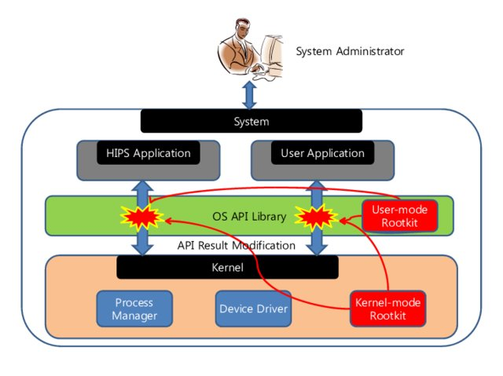
Rootkit Detections
Anti-virus software can attempt to scan for rootkits. A rootkit is a type of malware designed to gain administrative-level control over a computer system without being detected.
Rootkits can change how the operating system functions and, in some cases, can tamper with the anti-virus program and render it ineffective.
Rootkits are also difficult to remove.

Slide 8
AV detection Techniques - Heuristics
Many viruses start as a single infection and through either mutation or refinements by other attackers, can grow into dozens of slightly different strains, called variants.
Generic detection refers to the detection and removal of multiple threats using a single virus definition.
While it may be advantageous to identify a specific virus, it can be quicker to detect a virus family through a generic signature or through an inexact match to an existing signature.
Virus researchers find common areas that all viruses in a family share uniquely and can thus create a single generic signature. These signatures often contain non-contiguous code, using wildcard characters where differences lie. These wildcards allow the scanner to detect viruses even if they are padded with extra, meaningless code. A detection that uses this method is said to be "heuristic detection."

Slide 9
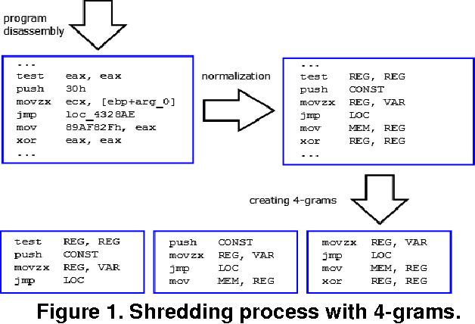

Slide 10
AV detection Techniques – Behavioral Blocking
Behavior detection is a signatureless approach to detection that helps the program build a full context around every process execution path in real time, and identify the stealthier, more advanced malware threats.
Suspicious behavior includes unpacking of malicious code, modifying the host files, or observing key strokes. Noticing actions like these allows an antivirus program to detect previously unseen malware on a system.

Slide 11
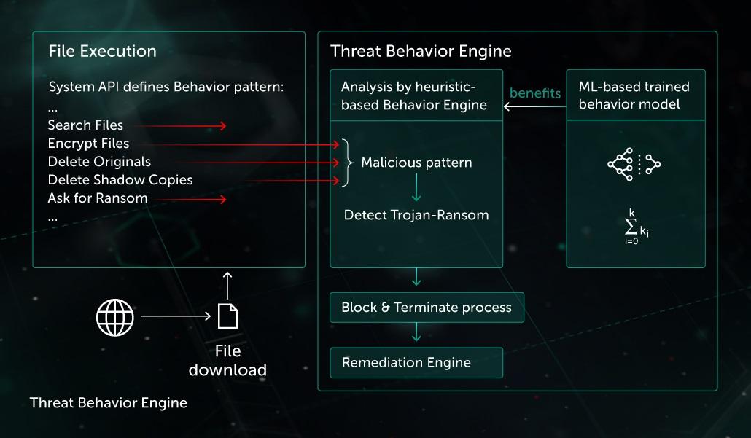

Slide 12
AV detection Techniques - Sandboxing
This is a behavioral based detection technique that executes the programs in a virtual environment, as opposed to detecting its fingerprint at run time.
Antivirus software that come with this type of detection capabilities execute programs in a separate, virtual environment, and log the actions it performs to determine whether the programs are malicious or not. If found safe, a given program is then executed in the real environment.
As you can imagine, this technique is both heavy and slow, and its resource intensive nature means that it is rarely used in consumer antivirus solutions.
End users may not always have the need for sandbox detection, but enterprises do, and antivirus solutions designed for corporate and network use offer this.

Slide 13
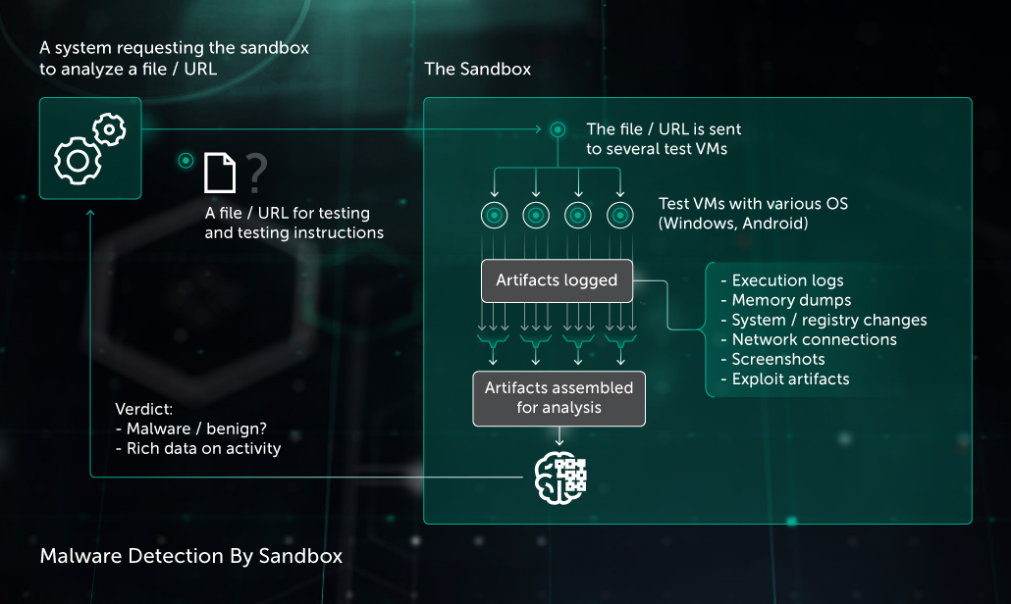

Slide 14
AV detection Techniques – Data Mining
This is one of the latest approaches in malware detection that security vendors now provide with their antivirus and antimalware products.
A series of features of files are extracted from files, and then data mining and machine learning algorithms are used to classify the behavior of a file and detect whether it has malicious intent or not.
This is particularly helpful in detecting and defeating the newest forms of malware in the wild.

Slide 15
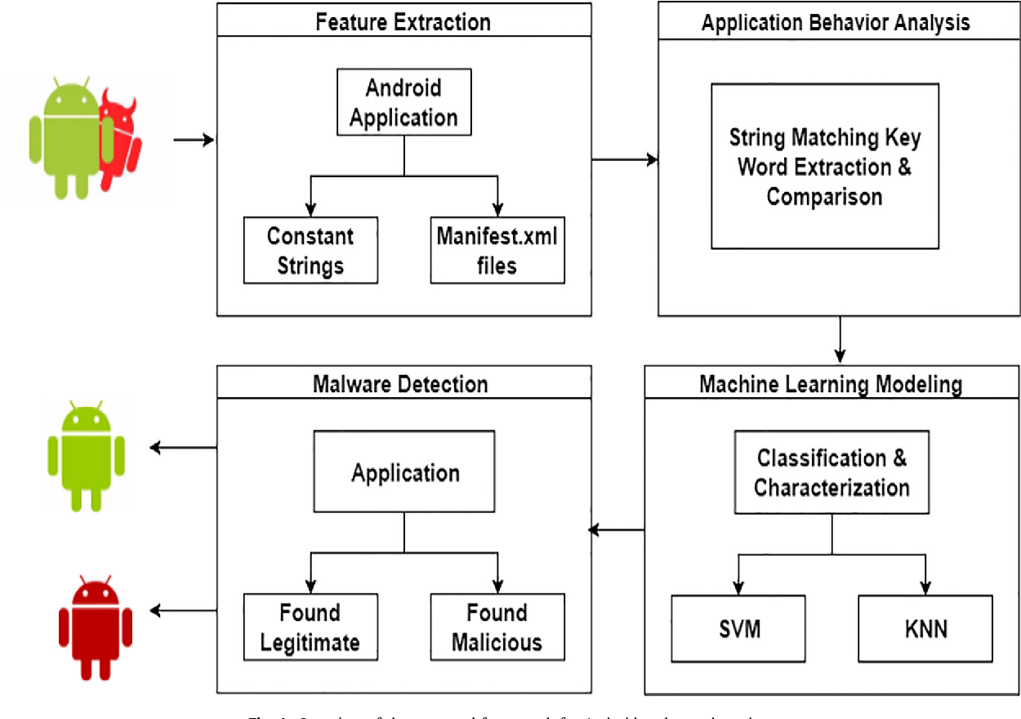

Slide 16
Anti-Virus Weaknesses
Definitions
Signature-based systems are inherently weak. It takes time to reverse-engineer malware, leading to a lag of a few hours to a few weeks to finally write a definition. Then there are systemic delays (it takes time to download and disseminate the definitions to endpoints.)
False positives
Anti-virus can be very frustrating for users and info sec alike. False positives may block legitimate software, and tie up resources in security.
Resource tie-up
Anti-virus needs computer resources to run. Sometimes during a full scan that can be significant, but even in off hours A/V is generating logs, scanning real-time (slowing processing, reserving RAM.) If A/V malfunctions it can even cripple a system.

Slide 17
Anti-Virus Weaknesses
Bloat / Unexpected Costs
A/V is ultimately a software package that remands regular updating. It’s not uncommon for the software to change, include bloated functions, or even push ads to the endpoint. At the very least, A/V adds another layer of complexity to systems. Another thing to go wrong, troubleshooting, etc.
Its efficacy can be marginal.
If A/V detects malware, that should mean you’ve had a near complete failure of your security systems. Hits should be rare. If it misses malware, you might not find out until it’s reported by a user. This causes some to question the wisdom in even supporting it as a security layer.

Slide 18
Testing Anti-Virus
Testing A/V is a relatively simple process most of the time. Just about every A/V contains a definition to react to the EICAR test string – a particular set of characters.
It is safe to pass around, because it is not a virus, and does not include any fragments of viral code. Most products react to it as if it were a virus (though they typically report it with an obvious name, such as "EICAR-AV-Test").
The file is a legitimate DOS program, and produces sensible results when run (it prints the message "EICAR-STANDARD-ANTIVIRUS-TEST-FILE!").
It is also short and simple - in fact, it consists entirely of printable ASCII characters, so that it can easily be created with a regular text editor. Any anti-virus product that supports the EICAR test file should detect it in any file providing that the file starts with the following 68 characters, and is exactly 68 bytes long:
X5O!P%@AP[4\PZX54(P^)7CC)7}$EICAR-STANDARD-ANTIVIRUS-TEST-FILE!$H+H*

Slide 19
Testing Anti-Virus
Other good choices –
WICAR is a browser security test site.
SpyShelter Test Tool is good for checking for spyware protection
Simulators
Trojan Simulator
RanSim from KnowBe4
System Shutdown Simulator

Slide 20
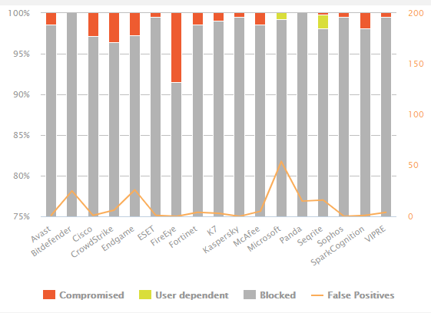
What makes a competent AV
While there are many AV technologies - the proof is in the pudding.
If an AV has some fancy new proprietary whatever then it’ll be visible in the methodology of the AV tests.

Slide 21
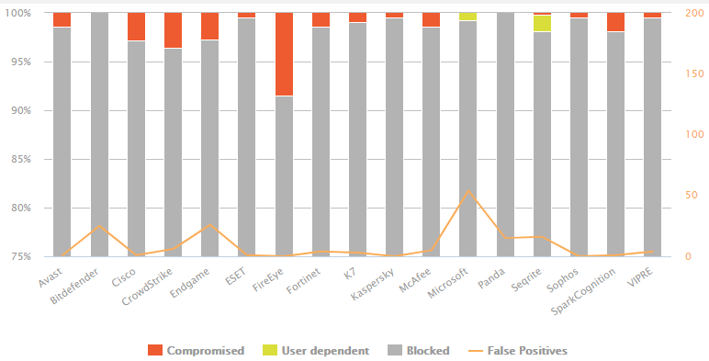
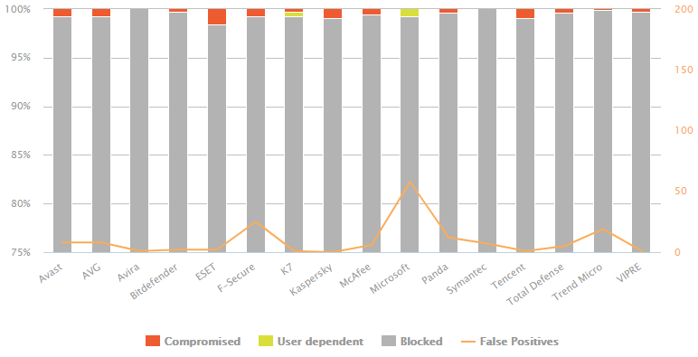

Slide 22
What makes a GOOD AV
It works.
It doesn’t contribute to bloat.
It doesn’t soak up too much of the security budget.
It shouldn’t be easy to disable.
It can be centrally managed.
Having a good administrative template is a good way to prevent local admins from working around it.

